Slide 1

Unit-IV
Neural Networks
Course In-Charges:
Dr.A.Mary Posonia
Dr.B.Ankayarkanni
SIT1305 Machine Learning

Slide 2
Unit-IV
Structure of brain
Neural networks as a parallel processing
Perceptron
Multilayer perceptron
  Backpropagation
  Training procedures
  Tuning the network size
  Learning time.
SIT1305 Machine Learning

Slide 3
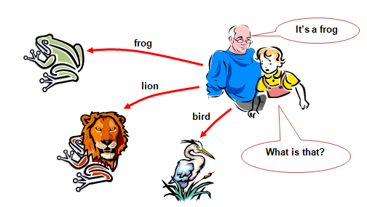
The idea of ANNs..?
NNs learn relationship between cause and effect or organize large volumes of data into orderly and informative patterns.
SIT1305 Machine Learning

Slide 4
Neural network: information processing paradigm inspired by biological nervous systems, such as our brain.
  Structure: large number of highly interconnected processing elements (neurons) working together
  Like people, they learn from experience (by example)
  Definition of ANN:
  “Data processing system consisting of a large number of simple, highly interconnected processing elements (artificial neurons) in an architecture inspired by the structure of the cerebral cortex of the brain”
SIT1305 Machine Learning

Slide 5
Neural Networks
Neural network, also referred to as an 'artificial' neural network (ANN), is provided by the inventor of one of the first neuro computers, Dr. Robert Hecht-Nielsen. He defines a neural network as:
  “ A computing system made up of a number of simple, highly interconnected processing elements, which process information by their dynamic state response to external inputs.“
Artificial Neural Network is a computational model that is inspired by the way biological neural networks in the human brain process information.
SIT1305 Machine Learning

Slide 6
Why use Neural Network?
Ability to derive meaning from complicated or imprecise data.
Extract patterns and detect trends that are too complex to be noticed by either humans or computer techniques.
Adaptive Learning
Real Time Operation.
SIT1305 Machine Learning

Slide 7
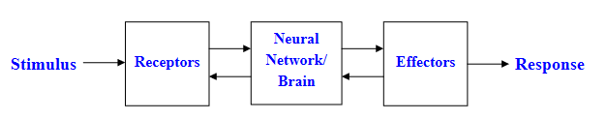
The Nervous System
The human nervous system can be broken down into three stages:
The receptors collect information from the environment – e.g. photons on the retina.
The effectors generate interactions with the environment – e.g. activate muscles.
The flow of information/activation is represented by arrows – feedforward and feedback.
SIT1305 Machine Learning

Slide 8
Levels of Brain Organization
The brain contains both large scale and small scale anatomical structures and different functions take place at higher and lower levels.
There is a hierarchy of interwoven levels of organization:
    1.Molecules and Ions
    2.Synapses
    3.Neuronal microcircuits
    4.Dendritic trees
    5.Neurons
    6.Local circuits
    7.Inter-regional circuits
    8.Central nervous system
SIT1305 Machine Learning

Slide 9
Brains versus Computers
There are approximately 10 billion neurons in the human cortex, compared with 10 thousands of processors in the most powerful parallel computers.
Each biological neuron is connected to several thousands of other neurons, similar to the connectivity in powerful parallel computers.
Lack of processing units can be compensated by speed. The typical operating speeds of biological neurons is measured in milliseconds (10-3 s), while a silicon chip can operate in nanoseconds (10-9 s).
Logical reasoning, critical thinking possible with brain. For Computers everything need to be programmed.
Brains have been evolving for tens of millions of years, computers have been evolving for tens of decades.
SIT1305 Machine Learning

Slide 10
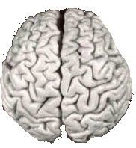

Comparison of Brains and Traditional Computers
Processing speed: 100 Hz
Parallel, Distributed
Fault Tolerant
Learns: Yes
Intelligent/Conscious: Usually
Tolerance: Fault tolerant, store and retrieve information even when interconnection fails, accept redundancies.
Processing speed: 10⁹ Hz
Serial, Centralized
Generally not Fault Tolerant
Learns: Some
Intelligent/Conscious: Generally No
Tolerance: No Fault tolerant, information corrupted if the network is disconnectes , no redundancies.
SIT1305 Machine Learning

Slide 11
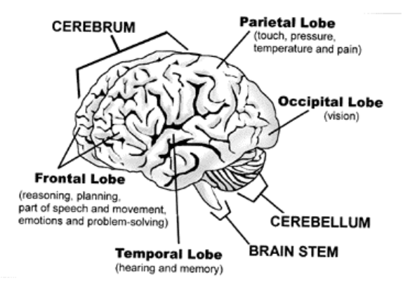
Structure of Brain
SIT1305 Machine Learning

Slide 12
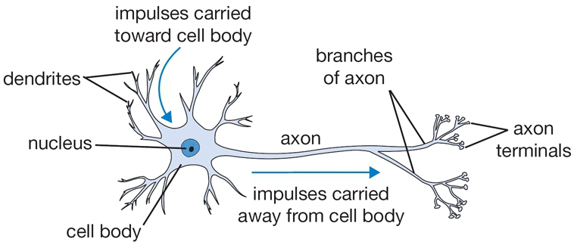
Biological motivation and connections
The basic computational unit of the brain is a neuron.
SIT1305 Machine Learning

Slide 13
Basic Components of Biological Neurons
The majority of neurons encode their activations or outputs as a series of brief electrical pulses (i.e. spikes or action potentials).
The neuron’s cell body (soma) processes the incoming activations and converts them into output activations.
Dendrites are fibres which originate from the cell body and provide the receptive zones that receive activation from other neurons.
Axons are fibres acting as transmission lines that send activation to other neurons.
The junctions that allow signal transmission between the axons and dendrites are called synapses. The process of transmission is by diffusion of chemicals called neurotransmitters across the synaptic cleft.
SIT1305 Machine Learning

Slide 14
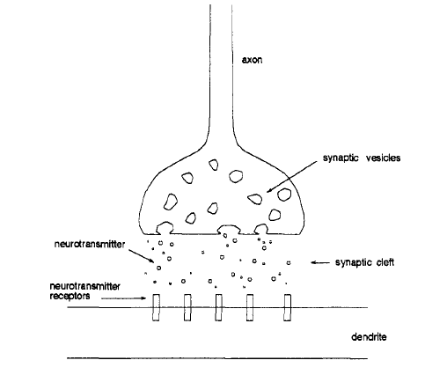
The synapse. Neurotransmitters released from the synaptic vesicles diffuse across the synaptic cleft and trigger the receivers on the dendrite.
SIT1305 Machine Learning

Slide 15
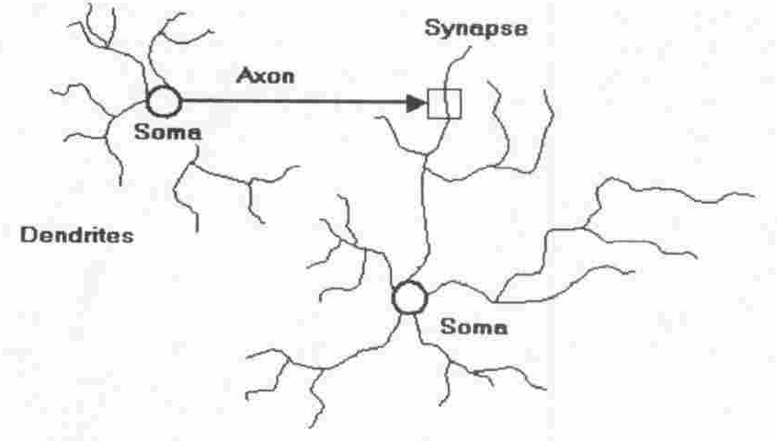
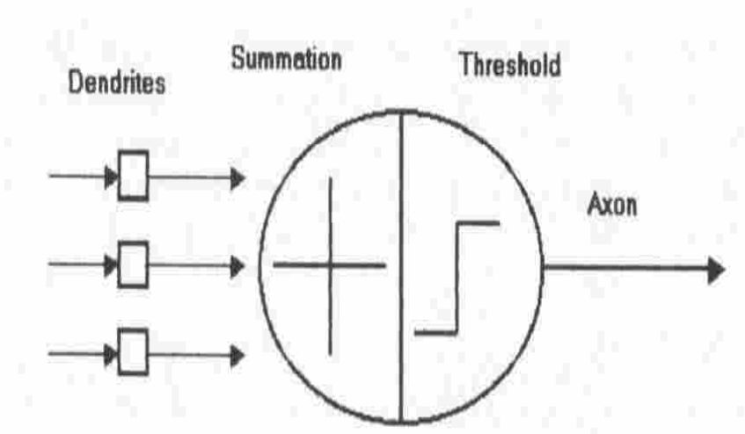
Artificial Neuron Model
Four basic components of a human biological neuron
The components of a basic artificial neuron
SIT1305 Machine Learning

Slide 16
The basic unit of computation in a neural network is the neuron , often called a node or unit.
It receives input from some other nodes, or from an external source and computes an output.
Each input has an associated
weight (w), which is assigned on the basis of its relative importance to other inputs.
The node applies a function to the weighted sum of its inputs.
The idea is that the synaptic strengths (the weights w) are learnable and control the strength of influence and its direction: excitory (positive weight) or inhibitory (negative weight) of one neuron on another.
SIT1305 Machine Learning

Slide 17
In the basic model, the dendrites carry the signal to the cell body where they all get summed.
If the final sum is above a certain threshold, the neuron can fire, sending a spike along its axon.
In the computational model, we assume that the precise timings of the spikes do not matter, and that only the frequency of the firing communicates information. we model the firing rate of the neuron with an activation function (e.x sigmoid function), which represents the frequency of the spikes along the axon.
SIT1305 Machine Learning

Slide 18
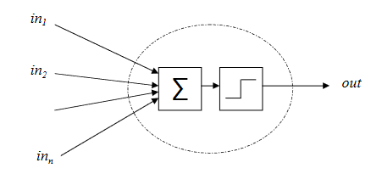
The McCulloch-Pitts Neuron
This vastly simplified model of real neurons is also known as a Threshold Logic Unit :
A set of synapses (i.e. connections) brings in activations from other neurons.
A processing unit sums the inputs, and then applies a non-linear activation function(i.e. squashing/transfer/threshold function).
An output line transmits the result to other neurons.
SIT1305 Machine Learning

Slide 19
Summary
Brain is parallel, distributed processing system.
Basic processing unit called the neuron.
Approximately 10¹¹ neurons each connected to 10⁴ others.
Operation of neuron: fires pulse down axon when sufficient input received from dendrites. Connections via chemical junctions called synapses.
Learning increases efficiency of synaptic junction.
Machines can learn through positive reinforcement.
Cerebral cortex shows local areas of specialized function.
SIT1305 Machine Learning

Slide 20
Characterization
Architecture
  a pattern of connections between neurons
    Feedforward
    Recurrent
Strategy / Learning Algorithm
  a method of determining the connection weights
    Supervised
    Unsupervised
    Reinforcement
Activation Function
  Function to compute output signal from input signal
SIT1305 Machine Learning

Slide 21
Neural Network Architecture
Input Nodes (input layer): No computation is in this layer, they just pass the information to the next layer. A block of nodes is also called layer.
Hidden nodes (hidden layer): In Hidden layers is where intermediate processing or computation is done, they perform computations and then transfer the weights (signals or information) from the input layer to the following layer .
Output Nodes (output layer): Use an activation function that maps to the desired output format (e.g. softmax for classification).
SIT1305 Machine Learning

Slide 22
Neural Network Architecture
Connections and weights: The network consists of connections, each connection transferring the output of a neuron i to the input of a neuron j. Each connection is assigned a weight w_{ij .}
Activation function: the activation function of a node defines the output of that node given an input or set of inputs. In artificial neural networks this function is also called the transfer function.
Learning rule: The learning rule is a rule or an algorithm which modifies the parameters of the neural network, to produce a favored output. This learning process typically amounts to modifying the weights and thresholds.
SIT1305 Machine Learning

Slide 23
Types of Neural Networks
1. Feedforward Neural Network
  A feedforward neural network is an artificial neural network where connections between the units do not form a cycle.
  The information moves in only one direction, forward, from the input nodes, through the hidden nodes (if any) and to the output nodes.
SIT1305 Machine Learning

Slide 24
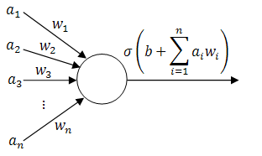
1.1 Single-layer Perceptron
This is the simplest feedforward neural Network and does not contain any hidden layer, which means it only consists of a single layer of output nodes.
Do not include the input layer, because at the input layer no computations is done, the inputs are fed directly to the outputs via a series of weights.
SIT1305 Machine Learning

Slide 25
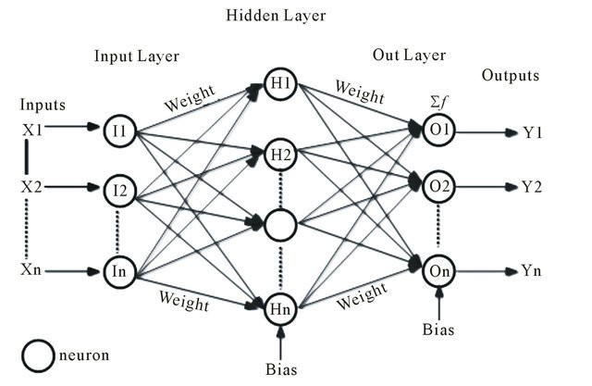
1.2. Multi-layer perceptron (MLP)
This networks consists of multiple layers of computational units, usually interconnected in a feed-forward way.
Each neuron in one layer has directed connections to the neurons of the subsequent layer.
In many applications the units of these networks apply a sigmoid function as an activation function. MLP are useful and they are able to learn non-linear representations.
SIT1305 Machine Learning

Slide 26
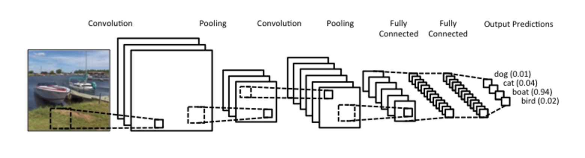
1.3. Convolutional Neural Network (CNN)
Convolutional Neural Networks are very similar to ordinary Neural Networks, they are made up of neurons that have learnable weights and biases.
In convolutional neural network (CNN, or ConvNet) the unit connectivity pattern is inspired by the organization of the visual cortex.
Unit response can be approximated mathematically by a convolution operation.
Variations of multilayer perceptrons that use minimal preprocessing.
Applications is in image and video recognition, recommender systems and natural language processing. CNNs requires large data to train on.
SIT1305 Machine Learning

Slide 27
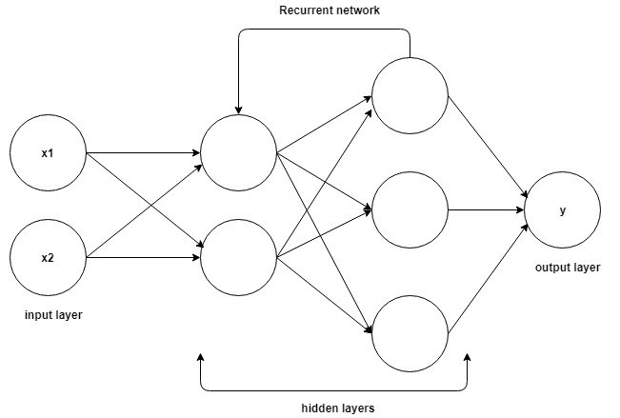
2. Recurrent neural networks
  Connections between units form a directed cycle.
  This allows it to exhibit dynamic temporal behavior.
  RNNs can use their internal memory to process arbitrary sequences of inputs.
  Applicable to tasks such as unsegmented, connected handwriting recognition, speech recognition and other general sequence processors.
SIT1305 Machine Learning

Slide 28
History
1943 McCulloch-Pitts neurons
1949 Hebb’s law
1958 Perceptron (Rosenblatt)
1960 Adaline, better learning rule (Widrow, Huff)
1969 Limitations (Minsky, Papert)
1972 Kohonen nets, associative memory
1977 Brain State in a Box (Anderson)
1982 Hopfield net, constraint satisfaction
1985 ART (Carpenter, Grossfield)
1986 Backpropagation (Rumelhart, Hinton, McClelland)
1988 Neocognitron, character recognition (Fukushima) …..
SIT1305 Machine Learning

Slide 29
Single Layer Perceptron
SIT1305 Machine Learning

Slide 30
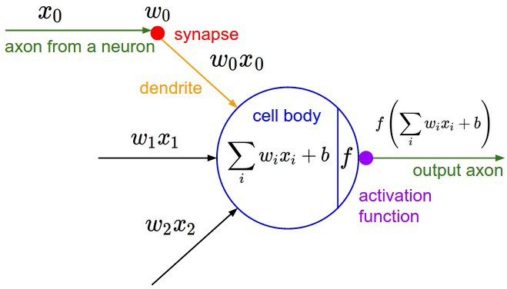
Model of ANN
SIT1305 Machine Learning

Slide 31
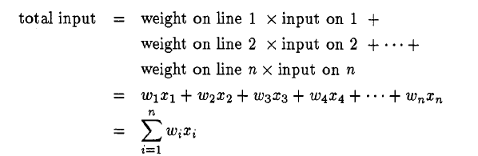
It performs a weighted sum of its inputs, compares this to some internal threshold level, and turns on only if this level is exceeded.
If not, it stays off. Because the inputs are passed through the model neuron to produce the output, the system is known as a feedforward network.
SIT1305 Machine Learning

Slide 32



The value of – θ is therefore known as the neuron’s bias or offset.
where f_{h} is a step function (actually known as the Heaviside function) and the function produces only a 1 or a 0, so that the neuron is either on or off.
Using the approach of biasing the neuron, defines an extra input 0, which is always set to be on, with a weight that represents the bias applied to the neuron. The equation describing the output can then be written as
SIT1305 Machine Learning

Slide 33
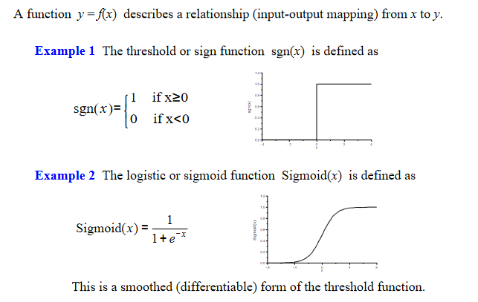
Activation Function
SIT1305 Machine Learning

Slide 34
Learning in Simple Neurons
Need a mechanism for achieving learning in model neuron.
Connecting these neurons together may well produce networks that can do something, but we need to be able to train them in order for them to do anything useful.
This learning rule proposed in 1949 by Donald Hebb, and is therefore called Hebbian learning.Hebb postulated ,that of reinforcing active connections only.
Since the learning is guided by knowing what we want to achieve, it is known as supervised learning.
SIT1305 Machine Learning

Slide 35
Learning in Simple Neurons
Learning paradigm can be summarized as follows:
  Set the weights and thresholds randomly.
  Present an input.
  Calculate the actual output by taking the threshold value of the weighted sum of the inputs.
  Alter the weights to reinforce correct decisions and discourage incorrect decisions-i.e. reduce the error
SIT1305 Machine Learning

Slide 36
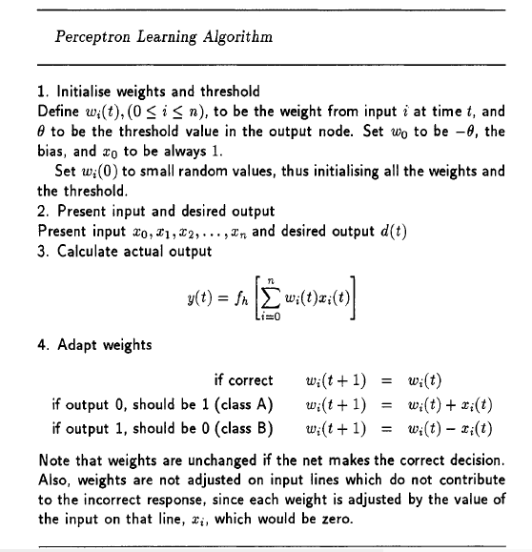
SIT1305 Machine Learning

Slide 37
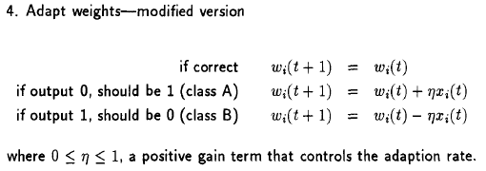
Various modifications have been suggested to this basic algorithm.
  The first is to introduce a multiplicative factor of less than one into the weight adaption term. This has the effect of slowing down the change in the weights, making the network take smaller steps towards the solution.
This alteration to the algorithm entails replacing step 4 with the following:
SIT1305 Machine Learning

Slide 38

Another algorithm was suggested by Widrow and Hoff.
They proposed a learning rule known as the Widrow-Hoff delta rule, which calculates the difference between the weighted sum and the required output, called the error.
Weight adjustment is then carried out in proportion to that error.
where d(t) is the desired response of the system, and y(t) is the actual response.
  if the desired output is 1 and the actual output is 0, Δ = +1 and so the weights are increased.
  Conversely, if the desired output is 0 and the actual output is 1 , Δ = -1 and so the weights will be decreased.
  Note that weights are unchanged if the net makes the correct decision, since d(t) – y(t) = 0.
SIT1305 Machine Learning

Slide 39
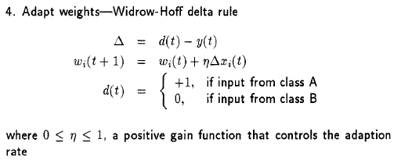
The learning algorithm is basically the same as for the basic perceptron, except step 4 is replaced by
SIT1305 Machine Learning

Slide 40
Neuron units using this learning algorithm were called ADALINEs (adaptive linear neurons) by Widrow, who also connected many of them together into a many-ADALINE structure, or MADALINE.
Another alternative proposed is to use inputs that are not 0 or
1 (binary), but are instead -1 or +1, known as bipolar. Using binary inputs means that input lines with 0’s on them are not trained,whereas bipolar values allow all the inputs to be trained each time.
This simple alteration helps to speed up the convergence process,but often leads to confusion in the literature as some authors discuss binary inputs and others bipolar ones. Effectively, they are equivalent,and the use of one or the other is usually a matter of personal preference.
SIT1305 Machine Learning

Slide 41
Implementing Logic Gates with MP Neurons
McCulloch-Pitts(MP) neurons to implement the basic logic gates (e.g. AND, OR, NOT).
Easy to construct any logical function from these three basic logic gates.
Find the appropriate connection weights and neuron thresholds to produce the right outputs for each set of inputs.
SIT1305 Machine Learning

Slide 42
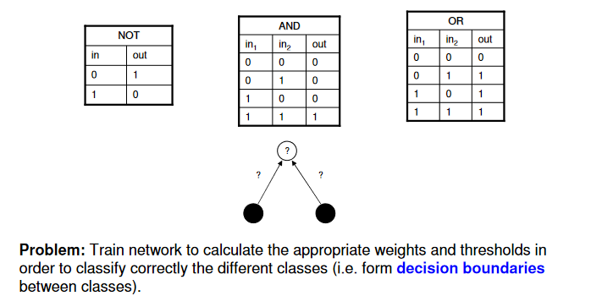
Implementing of Logical NOT , AND and OR
SIT1305 Machine Learning

Slide 43
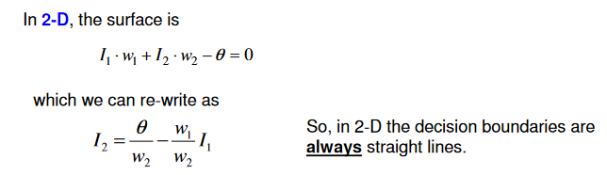
Decision Boundaries
SIT1305 Machine Learning

Slide 44
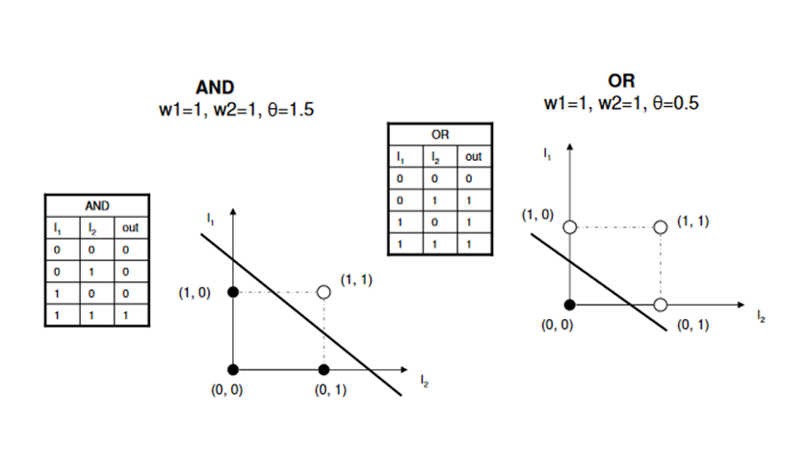
Decision Boundaries for AND and OR
SIT1305 Machine Learning

Slide 45
Implementation of OR gate
X1 | W1 | X2 | W2 | D | BIAS (θ) | Y | η | Δ
0 | 0 | 0 | 0 | 0 | 0.5 | 1 | 0.5 | 1
0 | 0 | 1 | 0 | 1 |  | 1 |  | 0
1 | 0 | 0 | 0 | 1 |  | 1 |  | 0
1 | 0 | 1 | 0 | 1 |  | 1 |  | 0
Iteration 1:
Y=Actual Output
D=Target /Desired Output
Δ = D – Y
η = Learning rate coefficient
Calculate Y:
SIT1305 Machine Learning

Slide 46
Implementation of OR gate
Update Weights and Bias
W1_{new}=W1_{old}-(η*Δ*X1)
W2_{new}=W2_{old}-(η*Δ*X2)
BIAS_{new}=BIAS_{old}- η*Δ
Iteration 2:
X1 | W1 | X2 | W2 | Y | BIAS (θ) | P | η | Δ
0 | 0 | 0 | 0 | 0 | -0.2 | 0 | 0.5 | 0
0 | 0 | 1 | 0 | 1 |  | 0 |  | -1
1 | 0 | 0 | 0 | 1 |  | 0 |  | -1
1 | 0 | 1 | 0 | 1 |  | 0 |  | -1
Calculate Y:
SIT1305 Machine Learning

Slide 47
Update Weights and Bias
W1_{new}=W1_{old}-(η*Δ*X1)
W2_{new}=W2_{old}-(η*Δ*X2)
BIAS_{new}=BIAS_{old}- η*Δ
Iteration 3:
X1 | W1 | X2 | W2 | Y | BIAS (θ) | P | η | Δ
0 | 0 | 0 | 0 | 0 | -0.2 | 0 | 0.5 | 0
0 | 0 | 1 | 0.5 | 1 |  | 1 |  | 0
1 | 0.5 | 0 | 0 | 1 |  | 1 |  | 0
1 | 0.5 | 1 | 0.5 | 1 |  | 1 |  | 0
Since Δ = 0 for all inputs, the weights values does not require updation.
Hence the model is trained or it has learned.
SIT1305 Machine Learning

Slide 48
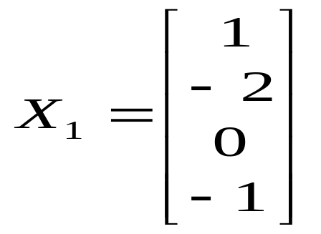
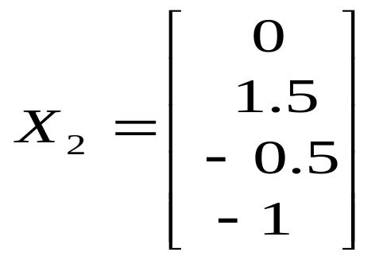
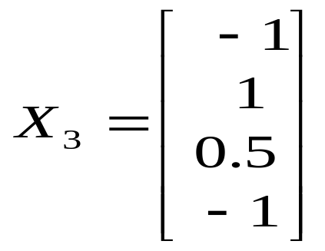
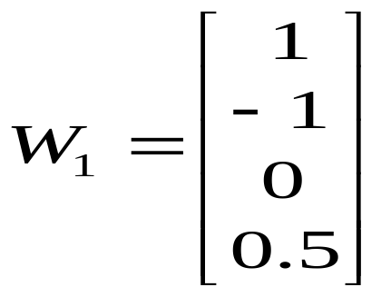
Problem 2
Use Perceptron learning rule to train the network. The set of input training vector are as follows:
And the initial weight vector is
The learning rate η=0.1
The desired response are
  d₁=-1, d₂=-1, d₃=1
SIT1305 Machine Learning

Slide 49
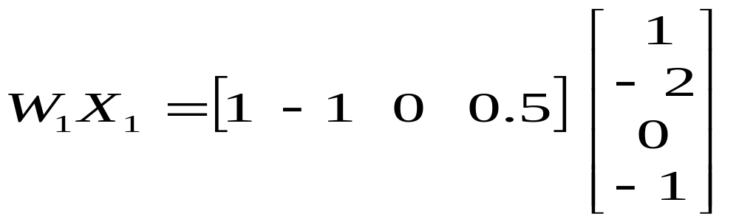

Iteration 1:
Step 1: Present the input X1 and compute the weighted sum.
Use sign function as thresholding function.
Step 2: Compute Y
Y₁=sign(2.5)=1
SIT1305 Machine Learning

Slide 50
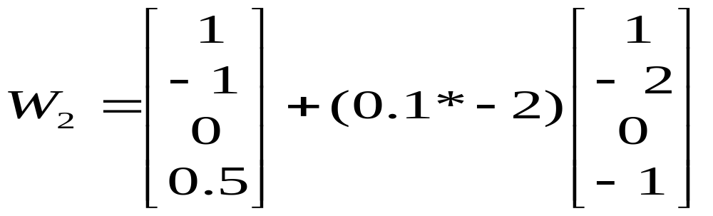
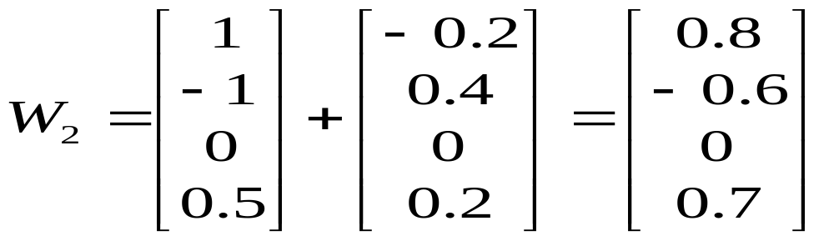
Step 3: Compute Δ ,the difference in desired output and actual output.
Δ=d₁-Y₁ = -1-1 = -2
Step 4: Update the weight values:
W₂=W₁+η*Δ*X₁
SIT1305 Machine Learning

Slide 51
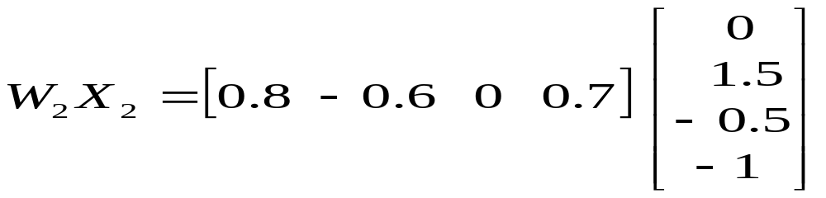
Iteration 2:
Step 1: Present the input X2 and compute the weighted sum.
Use sign function as thresholding function.
Step 2: Compute Y
Y₂=sign(-1.6)= -1
SIT1305 Machine Learning

Slide 52
Step 3: Compute Δ ,the difference in desired output and actual output.
Δ=d₂-Y₂ = -1+1 = 0
Step 4: Update the weight values:
W₂=W₁+η*Δ*X₂
Since the error is zero, the weights remain the same.
i.e., W₂=W₁
SIT1305 Machine Learning

Slide 53
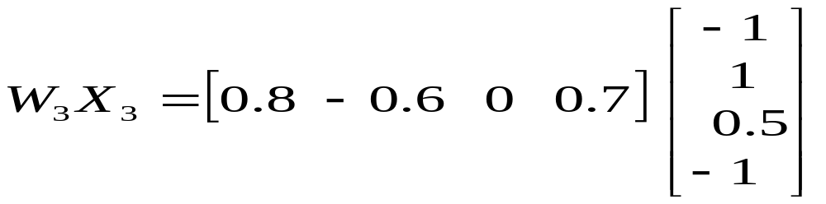
Iteration 3:
Step 1: Present the input X3 and compute the weighted sum.
Use sign function as thresholding function.
Step 2: Compute Y
Y₃=sign(-2.1)= -1
SIT1305 Machine Learning

Slide 54
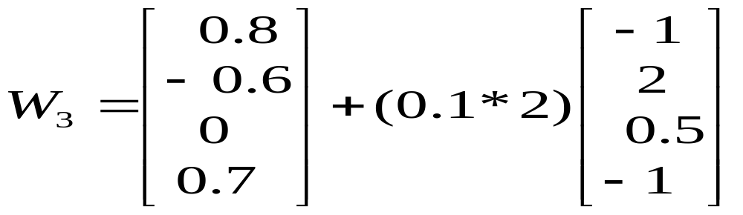
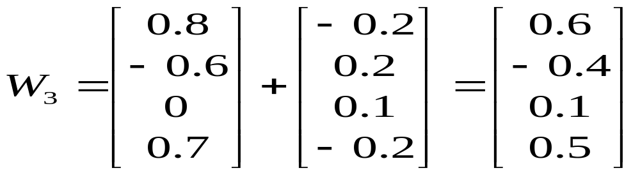
Step 3: Compute Δ ,the difference in desired output and actual output.
Δ=d₃-Y₃ = 1+1 = 2
Step 4: Update the weight values:
W₃=W₂+η*Δ*X₃
SIT1305 Machine Learning

Slide 55
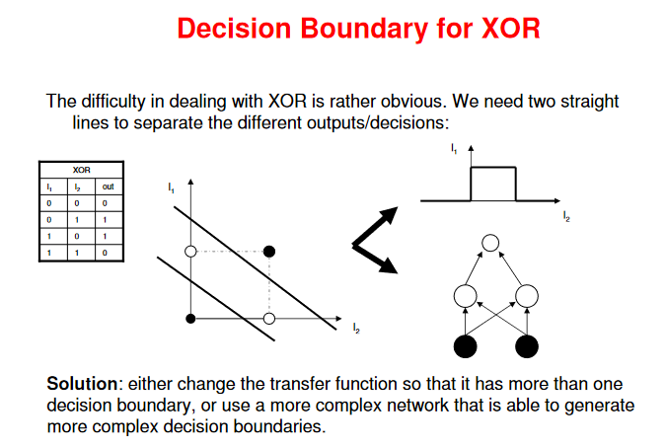
SIT1305 Machine Learning

Slide 56
Commonly used activation functions
Every activation function (or non-linearity) takes a single number and performs a certain fixed mathematical operation on it.
  Sigmoid
  Tanh
  ReLU
  Leaky ReLU
SIT1305 Machine Learning

Slide 57
Applications of Neural Networks
Neural networks can be applied to a broad range of problems and can assess many different types of input, including images, videos, files, databases, and more.
Image/pattern recognition,
Self driving vehicle trajectory prediction,
Facial recognition,
Data mining,
Email spam filtering,
Medical diagnosis, cancer research and many more…..
SIT1305 Machine Learning

Slide 58
Advantages
Single Layer Perceptron is quite easy to set up and train.
The neural network model can be explicitly linked to statistical models which means the model can be used to share covariance Gaussian density function.
The SLP outputs a function which is a sigmoid and that sigmoid function can easily be linked to posterior probabilities.
We can interpret and input the output as well since the outputs are the weighted sum of inputs.
Disadvantages
This neural network can represent only a limited set of functions.
The decision boundaries that are the threshold boundaries are only allowed to be hyperplanes.
This model only works for the linearly separable data.
SIT1305 Machine Learning

Slide 59
Multilayer Layer Perceptron
SIT1305 Machine Learning

Slide 60
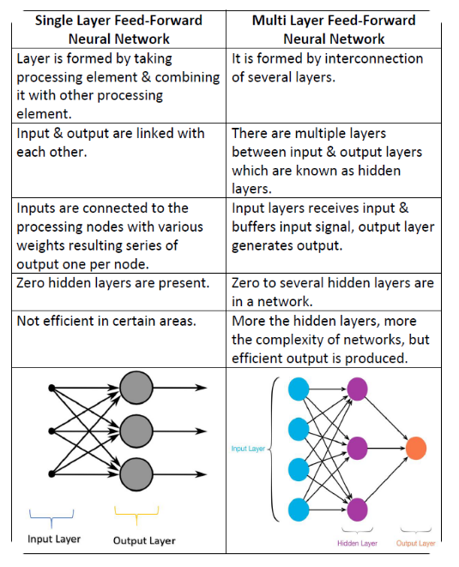
SIT1305 Machine Learning

Slide 61
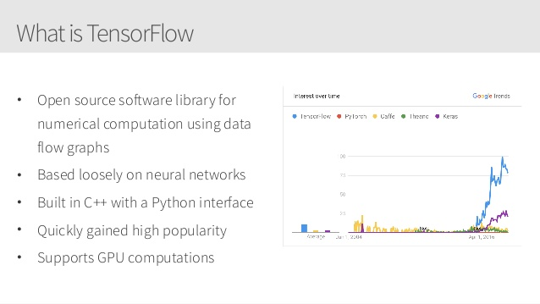
SIT1305 Machine Learning

Slide 62

SIT1305 Machine Learning

